Slide 1

An Integrated Model To Support Skills/Competencies Development
Professional Development Conference for Practitioners
April 10 - 11, 2014
Holiday Inn Hotel & Conference Centre
Truro, NS

Slide 2
L’Équipe d’alphabétisation-
Nouvelle-Ecosse
L’Équipe d’alphabétisation-Nouvelle-Écosse is a provincial non-profit literacy organisation offering French first language programs to adults and families throughout the province.

Slide 3
Adult programs
Traditionally l’Équipe offered only community based programming to Francophone adults wishing to upgrade their French reading, writing and communication skills.

Slide 4
Family Literacy
In 2004, l’Équipe received Federal Funds through the National Literacy Secretariat now Office of Literacy and Essential Skills to develop family literacy programming in an effort to promote literacy within Francophone families.
Over the next 10 years, l’Équipe developed a variety of family literacy programs and reach approx. 250 people every year in up to 15 areas of the province.

Slide 5
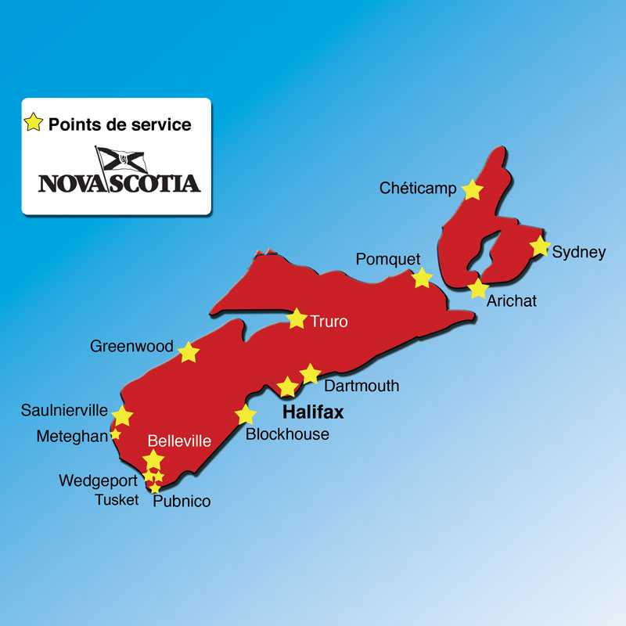
Service Points

Slide 6
LMA and Jobs Here Strategy
As the provincial government’s focus shifted towards employment we also began our journey towards developing programming to answer to the objectives of the government as well as the needs of adults with barriers to employment.

Slide 7
Our starting point
There were considerable discrepancies between the need for adults with low literacy skills to find a job and the services offered by other programs.
The training prioritized by these programs was more linear and academic, and was not really oriented toward the rapid acquisition of skills appropriate for the local jobs.
Notes:
Parking lot approach
Lenghty

Slide 8
A Chance Encounter
In 2009, while attending the AGM for Réseau pour le dévelopement de l’alphabétisme et les compétences (RESDAC), Donald Lurette, androgogical consultant and former literacy program facilitator, presented a brief overview of the integrated model approach.
Notes:
The CAP is a community organization that is mainly responsible for offering training services to adults with low literacy skills in the Hawkesbury area, in Eastern Ontario.

Slide 9
Integrated training programs
They are for a predetermined amount of time;
They lead quickly to employment;
They often include one or several forms of certification or recognition;
The literacy training component provides for educational support all along the pathway to specialized training.
Their participation costs are minimal;
They take into account the main structural and psycho-social barriers that can affect the participation and learning of a clientele with low literacy skills;
Notes:
The first TGV was developed for millwrights with no certification, but many years experience, who found themselves unemployed after many years and could not find work because they did not have a certification or even a grade 12 diploma.

Slide 10
Benefits of the integrated training programs
Benefit from the many educational resources of different partners;
Receive instructional and logistical support adapted to the learning obstacles they face and their complex needs;
Receive an education that is adapted to their level of literacy and relevant to their needs for socio-economic insertion;
Obtain formal certification or recognition for their learning;
Participate in a preparatory process with a view to integrating the labour market or another project important to them; and,
Promotes participation in various aspects of community life.
Notes:
We had a plan!

Slide 11
RESDAC
2011
RESDAC adopts integrated model as best practice for competency development for Level 1 and 2 adults with barriers to employment.
RESDAC project includes NS (support-Donald, Inquire, Research and Evaluation)
Notes:
Resdac model in line with our needs
Meetings with Department early on
RESDAC chooses NS as part of their larger project – describe project (4 provinces, 2 pilots / province)

Slide 12
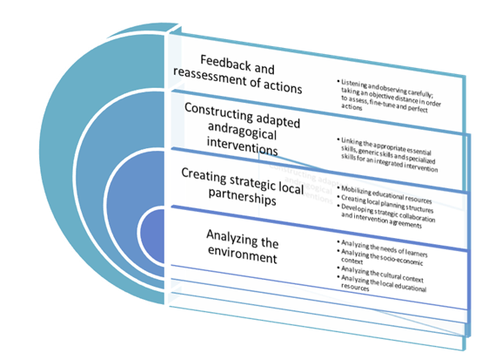
The components of an integrated training program
Notes:
In a nutshell, the RESDAC integrated model is based on 4 main axes.
Although these components are presented one after the other they should not be perceived as a linear model but more as an interconnected model where each component should influence each other.
Analyzing the environment
Analyzing the needs of learners
Analyzing the socio-economic context
Analyzing the cultural context
Analyzing the local educational resources
2. Creating strategic local partnerships
Mobilizing educational resources
Creating local planning structures
Developping strategic collaboration and intervention agreements
Constructing andragogical interventions
Linking the approriate essential skills, generic skills, and specialized skills for an integrated intervention
Feedback and reassessment of actions
Listening and observing carefully
Taking an objective distance in order to assess, fine-tune and perfect actions

Slide 13
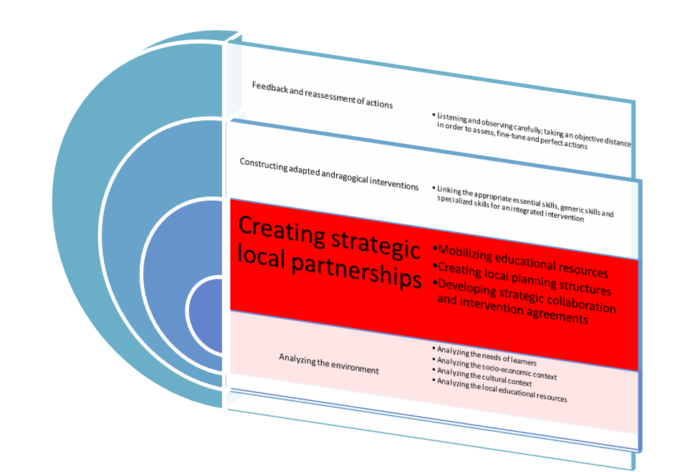
Creating Partnerships
Phase 1 (March 2012)

Slide 14
Partners
Université-Sainte-Anne (Tusket campus),
Municipality of Argyle,
Conseil acadien de Par-en-Bas,
Conseil de développement économique de la N.-É. (CDENE),
Argyle Employment Services,
West Nova Inclusive employment society,
Department of Labour and Adavanced Education
DCS
Notes:
Discuter les rôles des divers partenaires
USA – Locale, computers, technical support,
Mun of Argyle – Knowledge of area, potential employer
CAPEB – Knowledge of the needs of the French population in Argyle, potential employer
CDÉNÉ – Economic situation of the area
Argyle employment services – clientèle, Programs, recrutement
WNIES – Clientèle, recrutement
Department – Funding, liaison
DCS – Funding, recrutement

Slide 15
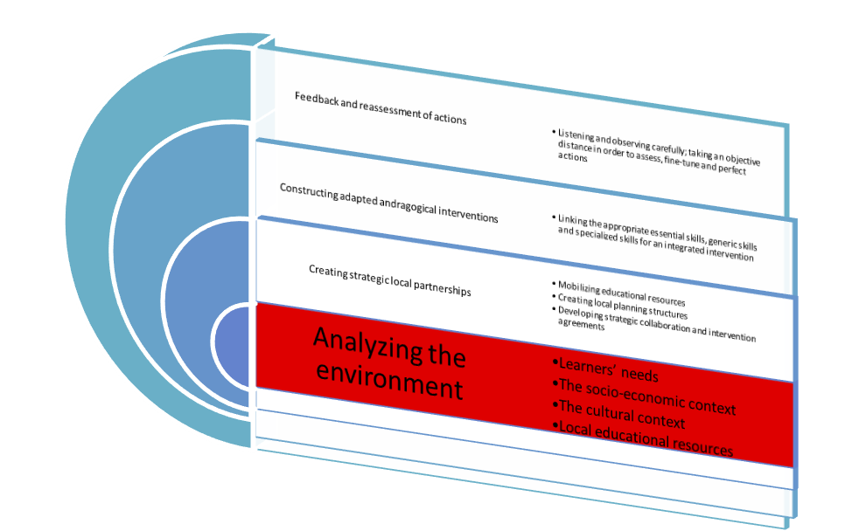
Environmental Scan
Phase 1 (March 2012 – June 2012)

Slide 16
Research And Data Collection
Interviews with 28 local employers
Open ended questions
Focus Group
Notes:
We hired le CDÉNÉ to interview 28 local employers.
The list of employers was varied (restaurants, retail stores, car dealerships, lawyers office, nursing homes, financial institutions, fish plants…)
The interviews served a double purpose; EANE and USA
Determine the job sector that we should target with our training program
Determine the skills employers were looking for in employees
Determine with technical skills were necessary in their work environment
Provide information to USA about potential workplace education programs

Slide 17
Which skills are necessary for the positions within your business/organisation?
Good interpersonal skills / Teamwork
Communication (in both languages) oral, written and reading
Basic math skills
Willing to learn new things
Good work ethic
Good customer service skills
Respectful of others
Notes:
Ask the group what they think the answers were.
La liste complete à la page 24 Rapport du CDÉNÉ

Slide 18

Required skills within the workplace
Notes:
Employers are looking for employees with the right soft skills (55.26%) and essential skills (35.53%).
Only 9.21% of answers were related to technical skills.

Slide 19
Upon hiring, what are you looking for in an employee?
Teamwork
Good communication
Good presentation
Honesty
Self confidence
Motivation (asks questions to help move things along)
Notes:
Complete answers on page 27 Rapport CDÉNÉ.

Slide 20
Skills required to gain employment
Notes:
Employers identified the need for employees to: work independantly (67,86 %), have good interpersonal abilities (64,43 %) and a good attitude at work(35,71 %).
Six of 28 employers (21,43 %), noted the importance of having an honest staff.
Regarding essential skills, 46,43 % of employers mentionned the need for employees to work well with others.
7,14 % were looking for employees with computer skills.
Technical skills required for obtaining a job varied depending of the type of workplace or job. Some valued an experience in law, or in the French language and
Acadian culture, or even some work experience with patients suffering from Alzheimer or other forms of dementia.

Slide 21
Soft Skills Identified By Employers

Slide 22
Essential Skills Identified by Employers

Slide 23
A Model Employee

Slide 24
A Model Employee
Soft Skills vs Essential Skills

Slide 25

A Leap Of Faith
Notes:
And we almost died.

Slide 26

Bilingual Customer service representative
Notes:
Since we interviewed such a variety of different types of employers, it was difficult to find a job sector that was screaming for employees. The only common thread we found in most of the employers, was a need for customer service. It was a logical choice for us since we had the infrastructure to support that type of training as opposed to something like mechanics or boat builders for example.
With no experience in curriculum development it was easy for us to focus more on developing a curriculum that would promote the development of tasks rather than more standard literacy curriculums.

Slide 27
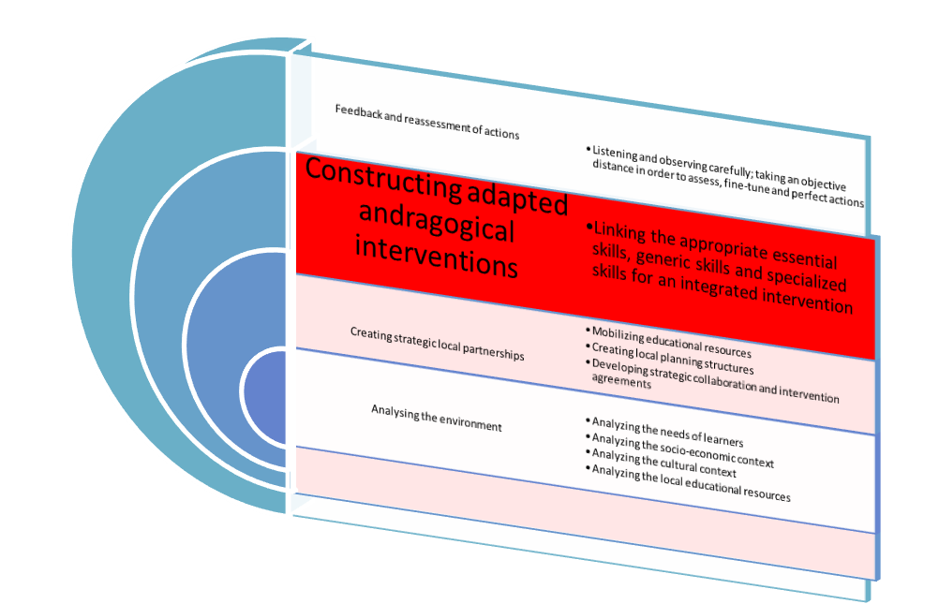
Curriculum Development
Phase 2 (January 2013 – June 2013)
Notes:
During this time we also worked on participant recruitment and solidifying partnerships.

Slide 28
What skills /competencies to develop?
    In order to achieve a strong and lasting connection to the workforce, people need three complimentary skill sets.
Futureworx

Slide 29
The Skills Pyramid
TECH
Technical skills are skills specific to a given job. For example:
  Driving a bulldozer
  Giving a bed bath
  Futureworx
Notes:
HIDDEN
If someone is lacking technical skills – those specific to a job, there are resources to help them.

Slide 30
The Skills Pyramid
ESSENTIAL
TECH
Reading
Writing
Numeracy
Document Use
Computer Skills
Futureworx
Thinking Skills
Continuous Learning
Oral Communication
Thinking Skills
Notes:
HIDDEN
Likewise there are resources that specifically target the development of essential skills like reading, writing, numeracy, document use etc.

Slide 31
The Skills Pyramid
EMPLOYABILITY
ESSENTIAL
TECH
Also called ‘soft’ skills or personal management skills. These are the foundation upon which all skills are built.
Futureworx
Notes:
HIDDEN
Employability skills are different. While some programs have personal development components, employability skills are typically not recognized as outcomes that are systematically targeted and assessed as part of program delivery.
What we see in the field is when employability skills are not specific outcomes then it is easy for practitioners to focus on technical or essential skills .
Others find such difficulty in addressing employability skills that they do so inconsistently if at all.

Slide 32
Fundamental Question
What role do essential skills, generic skills, second-language skills or specialized skills play in meeting the integration needs of the targeted clientele?
Notes:
The fundamental question for curriculum development!
Once we decided on customer service, we re-interviewed some employers to help us better understand which tasks we should be focusing on. Essentially, what do your employees need to know/do to work in customer service for you. We got a list of different tasks:
answering the phone
e-mails
answering client questions
using Word
Using an adding machine
Using a cash register
Sales
Etc…
We also checked the National occupancy codes for various jobs such as:
Receptionist
Hotel front desk
Retail
To round out a fairly extensive list of tasks that we would train for.

Slide 33
In the context of doing a task, these diverse skills must fit together seamlessly: sometimes one completes the other and sometimes one supports the other, either in the learning process or in action (carrying out a task).
Notes:
Essentially, the integrated model encourages the development of all the skills necessary to accomplish a specific tasks.
Example:
If the task is answering the telephone then putting someone on hold, we need to dissect the task into the skills required to execute it.
Press the button to answer the line - technical
Deliver required greeting – essential, technical
Have a warm tone and be courteous - generic
Deliver standard statement to put someone on hold – essential, technical
Press hold button- technical

Slide 34
The customer service program will promote:
The basic skills of excellent customer service
Professional communication techniques
Software and digital technology necessary in the customer service field
Excellent employability skills and attributes

Slide 35
The curriculum framework
Personal Development - compulsory
Introduction to Customer Service - compulsory
Basic Computer Skills and Digital Technology – compulsory
Work placement – compulsory
1ST Aid and CPR – optional
Occupational Health and Safety-optional
Foodsafe level 1 – optional
WHMIS – optional
Mental Health First Aid - optional

Slide 36
Personal Development
The Professional Development course will give the students the opportunity to gain insight into themselves as well as others. This knowledge will help them develop the necessary employability/generic skills to successfully gain and retain employment in the customer service field.

Slide 37
PD Modules
Employability Skills Assessment Tool- (In depth development of 9 employability Skills: Motivation, attitude, accountability, time management, stress management, presentation, teamwork, adaptability and confidence)
ABC’s of Physical Appearance
Mental Health 1st Aid
Nutrition
Stress Management
Portfolio
Personality Dimensions
Simulated Work Environment Projects
Public Speaking

Slide 38
Customer Service
This course will offer students a variety of modules that will familiarize them with the best practices relating to excellent customer service, in person, on the phone and by e-mail. The goal is to understand the basic principles of customer service as well as its importance in the overall satisfaction of the customer.

Slide 39
Customer Service modules
The Importance of Customer Service
Receiving Clients
Professional Communication Techniques
Billing (math skills relating to customer service tasks)
Unhappy Customers
How To Be A Successful Salesperson
Forms

Slide 40
Basic Computer Skills and
Digital Technology
Computer skills have become essential in today’s workplace. Our students will be introduced to a variety of basic notions, software and digital technologies in order to develop the computer skills necessary to succeed in the customer service field.

Slide 41
Technology Modules
Word
Digital Technology
Excel
Internet
E-mail
Responsible use of social media
Information research

Slide 42
Our EvaluationToolbox
Camera (Communication and Math Employment readiness Assessment) - Intake
Esat - (Employabity Skills Assement Tool)
Competency Assessment

Slide 43
CAMERA
http://www.ptp.ca/wp-content/uploads/2009/01/camera-e-booklet.pdf
Notes:
We did our CAMERA training with Futureworx.

Slide 44
ESAT
Generic or employability skills are evaluated using the ESAT tool developed by Futureworx Work Centre, Truro.

Slide 45

Employability skill development gets less emphasis. Why?
Futureworx
Notes:
HIDDEN
Employability skills are different. While some programs have personal development components, employability skills are typically not recognized as outcomes that are systematically targeted and assessed as part of program delivery.
What we see in the field is when employability skills are not specific outcomes then it is easy for practitioners to focus on technical or essential skills .
Others find such difficulty in addressing employability skills that they do so inconsistently if at all.

Slide 46
Our experience :
Lack of a common framework and language
Seen as abstract concepts
Belief they are acquired by osmosis
Often involve sensitive issues and potentially conflict
Hard to manage:
  Lacking tools for assessment or tracking progress
  Takes time to facilitate change
  Requires specific orientation and training in staff
Futureworx
Notes:
HIDDEN
Framework – would you choose the same 9 skills? Would we all agree on what they encompass? Would the learners we deal with understand?
There seems to be an assumption that people should just have these skills inherently. Who is responsible form developing them? If a youth does not have them, who takes on the task of developing them?
Of course many of these issues are personal and complex. Behaviours that are suitable for the workplace may be important survival mechanisms. Talking to someone about their hygiene is not easy.
Few consistent measurement tools – even fewer that have quantitative elements.
All of this suggests, rightly, that it takes a lot of time and effort to address these issues, but, nevertheless, doing so is critical.

Slide 47
Ensure employability skills are a focus by:
Providing a clear framework of employability skill definitions and expectations
Creating an environment in which action on employability skills is seen as an obligation
Providing tools to support action and assessment in a respectful, consistent manner
Providing training to help people understand the tools and the methods.
Notes:
HIDDEN
It was as part of this effort that we began the development of ESAT. We saw the need to help our staff maintain a consistent standard across initiatives, and subsequently received requests from other organizations to help then work in this area.
CHRISTA ESAT

Slide 48
Competency Assessment
The success of the participants will be evaluated by their ability to complete specific tasks associated to the customer service field. (Ex. Writing a receipt, answering the phone and placing a client on hold, sending and receiving e-mail…).
Notes:
Similarly to the curriculum development stage, we broke the tasks down into the skills needed to execute them and built our evaluations around that.
Tasks that were concrete ( sending an e-mail) were easily evaluated - If the required e-mail entered the inbox, we judged that they were able to execute the task.
If the assignment asked for a professional email, we evaluated the content more carefully.
If the task was more generic in nature ( dealing with unhappy customers) we did role playing activities where the participants were asked to show us how they would react and deal with an unhappy customer. With this type of evaluation we were able to evaluate all the skills that were necessary to perform a specific task.

Slide 49
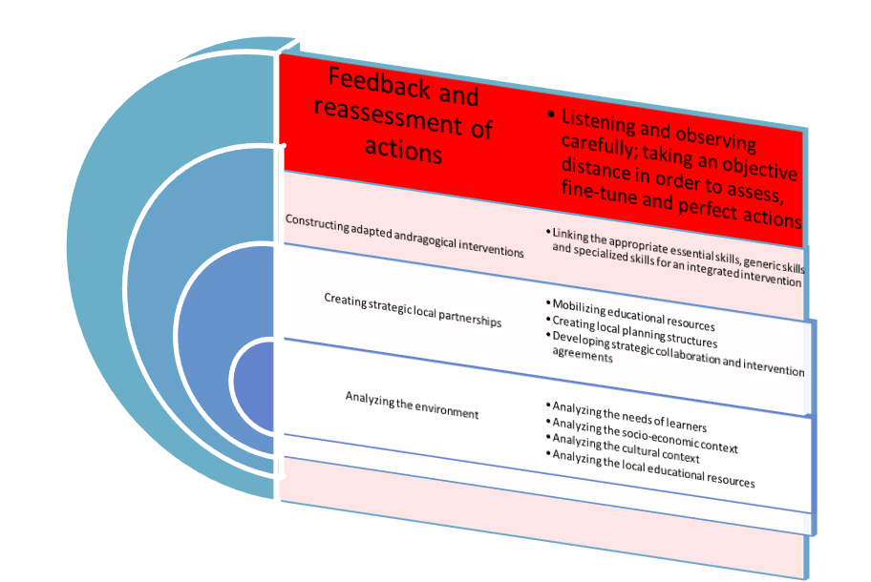
Phase 3

Slide 50
Participant Recrutement
  DCS
  Université Sainte-Anne
  CRC’s
  WNIES
  Community forums
  School boards
  Women’s centres/groups
  Adult Learning Centres
Notes:
We phoned, visited, pitched the project early on to as many people as we could. Sometimes looking for funding partners, sometimes looking for referral agencies, sometimes both.

Slide 51
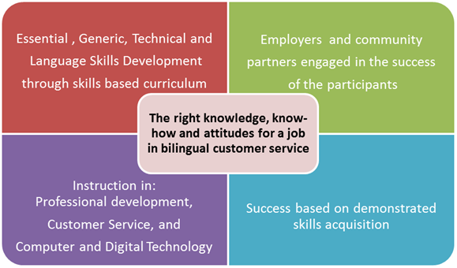
Pilot Project

Slide 52
Time frame
Start date: October 28th, 2013
End date: May 1st , 2014
18 weeks class time
5 weeks work placement
Notes:
We had to take 4 weeks off at x-mas because of a staff change.

Slide 53
Participants
9 intakes
1 decided against enrolling
2 were not accepted in the program
6 were registered to start in October
3 showed up

Slide 54
Recrutement - round 2
December 2013 we proposed the possibility of recruiting more participants in an effort to increase our numbers.
Notes:
We proceeded with a 2 block approach.
The competency approach allowed an easy split between the material covered in the first half (Block A) and what remained in the second (Block B).
We added 2 participants to the group.

Slide 55
Block A / Block B
Each block is independent of the other.
Both blocks must be completed in order to receive the completion certificate.
Entry is possible at Block A and Block B.
A one week catch up is required between Block A and Block B.

Slide 56
Staff
3 part time staff share the teaching responsibilities.
They collaborate to offer complimentary activities that can be evaluated on many levels.
Ex. Take a call and find information in a database.
We can evaluate the technical skills (phone and computer) as well as the generic skills (courteous, attitude) all in the same activity.
Notes:
If the PD instructor was focusing on stress management, the Customer service instructor might present stressful customer service scenarios in a role playing activiy.
Staff collaboration was essential in offering a cohesive program that flowed naturally.
It is also essential in ensuring the success of ESAT.

Slide 57
Employers
Provided guidance in curriculum development
Validated the curriculum framework
Took students for work placements
Presented information sessions to the class (What are employers looking for in an employee? What skills are necessary/important in the workplace?)

Slide 58
Work placements
2 week observation placement
3 week integration placement (Final Exam)
Notes:
Observation placement used to evaluate the training needs of the participants
Integration placement is really the final exam. Were the participants able to perform the required tasks.

Slide 59
What’s next?
Evaluation
Funding
Recrutement
New partners
Notes:
Evaluation – curriculum, time frame, partners, outcomes, difficulties
What worked well – less?

Slide 60
Questions / Comments

Slide 61
Merci
☺
Ghislaine d’Eon
Directrice générale
L’Équipe d’alphabétisation-Nouvelle-Écosse coordination.eane@nald.ca
902-648-0501

