Slide 1
LNS Learner Supports Conference
Truro
April 22, 2013

Slide 2
Agenda
Change at NALD
Tools and Resources on NALD
Library
ES Assessment Tools Database

Slide 3
Change at NALD
Challenged to reduce reliance on OLES
Shift from “Literacy” to “LES”
Shift from “Church basement to shop floor”
Austerity budgets all across the country.
Web tools and experience has evolved.

Slide 4
Vision
NALD will be recognized as an innovative and valued contributor to advancing learning in Canada.

Slide 5
Mission
We are the lead network that Canadians rely on to connect them with information, tools, resources, knowledge and expertise to enhance life-long and life-wide learning.

Slide 6
Values & Guiding Principles
As an organization, NALD holds the following Core Values and Guiding Principles:
Learning, in all its forms and at all stages of life, is at the centre of everything we do.
We value independence and self-reliance, both as an organization in what we do, and in the transformational impact that improved literacy skills have on the lives of those whom we ultimately seek to support.
We play a leadership role in knowledge exchange and mobilization, information dissemination and using the latest technology to support those whom we serve. We freely share information as a communications hub and work to build capacity in the field.
We seek to work collegially with others, in partnership and collaboration, with mutual trust and support, to achieve our common objectives.
We value excellence in customer service, with a focus on understanding our customers’ needs and offering them valuable solutions.
We value our relationships with our partners, stakeholders, clients, suppliers and other members of our network in the learning community.
We are proud to offer services in both of Canada’s official languages from Canada’s only bilingual province.
We work as a professional team in a learning environment, accountable to each other, our funders, and to those who rely on our services.

Slide 7
What’s Ahead for NALD
Branding
Expanding beyond traditional “markets”
Looking for more partnerships & projects
Connecting you to information, tools, resources, knowledge and expertise

Slide 8
The Struggling Learner
Mental Health Issues
Disabilities
Socio-economic factors
Substance Abuse
Personality Traits
Issues in the home

Slide 9
Regardless of Underlying Cause
Literacy Development is a critical step
Programs/Services tailored to needs of the learner work best
Building Self-Esteem, Self-Respect and Confidence

Slide 10
Tools/Resources on NALD
Toward a "Whole Life" Perspective on Learning Disabilities in Adult Literacy Settings
Employment Access for Persons with Disabilities
Story of the Week

Slide 11

Tools/Resources on NALD
The effectiveness of work-experience programs in Canadian high schools
A barrier to learning: Mental health disorders among Canadian youth
Canada slow to overcome limits for disabled learners

Slide 12
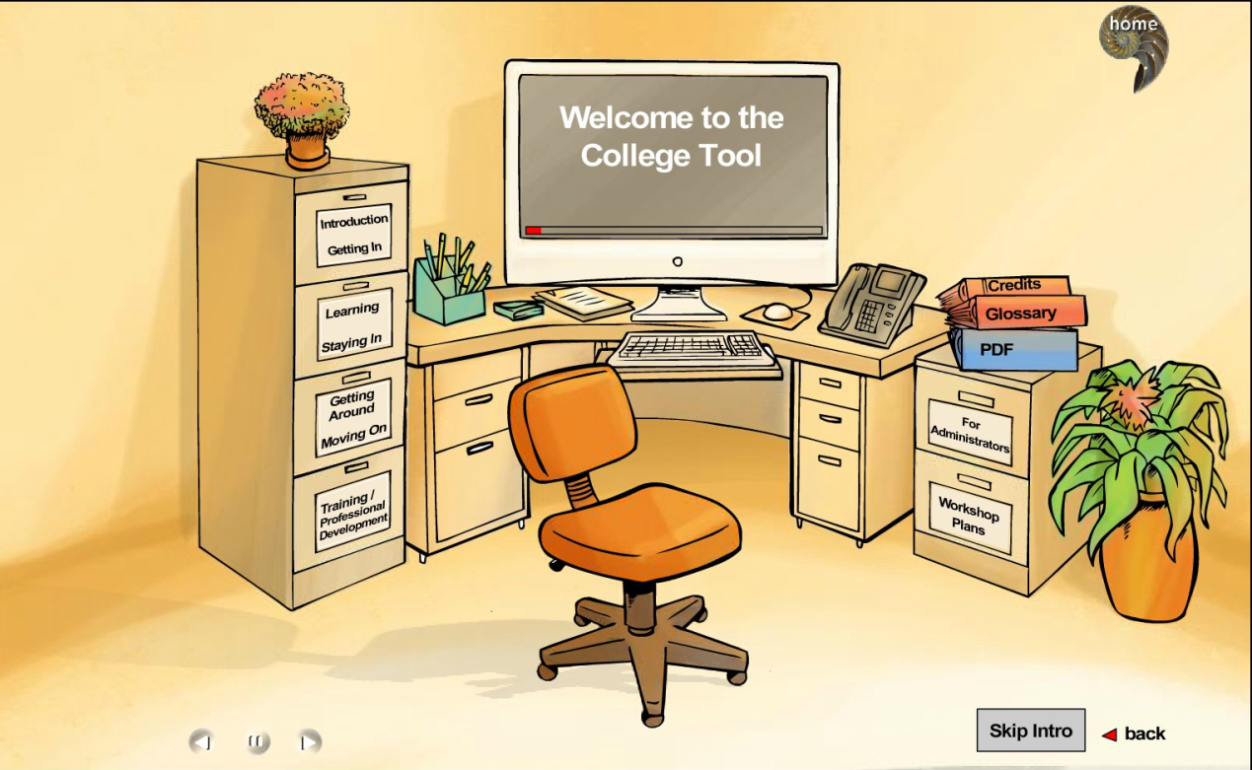
Learning and Violence
www.learningandviolence.net

Slide 13
Employability Tools
Connecting Literacy and Employment through Essential Skills
Workforce Literacy Essential Skills (WLES) Pilot Project

Slide 14

Library

Slide 15
Upcoming Webinar
NALD Library
    Effective Search Strategies
    How to find what you are looking for
    Tips and Tricks
Hosted by NALD’s Library Manager Lorette Melanson
May 8 2:30-3:30 pm
Watch our site or Weekly Update for registration

Slide 16
Thank you
Bill Stirling
bill.stirling@nald.ca
1-800-720-6253

